Slide 1
Object Detection with Tensorflow
Done by
T.Sudharssan
III Year CSE
Reg.No. :912321104046
SACS MAVMM Engineering College
Madurai

Slide 2
Project Outline :
1.Problem Statement
2.Proposed System/Solution
3.System Development Approach
4.Algorithm and Deployment
5.Result
6.Conclusion

Slide 3
Problem Statement :
Object Detection with TensorFlowThe objective is to develop a system that can automatically identify and locate multiple objects within an image or video stream using TensorFlow, a popular open-source library for machine learning.Identifying and detecting objects within images or videos is a key task in computer vision. It is critical in a variety of applications, ranging from autonomous vehicles and surveillance systems to augmented reality and medical imaging. TensorFlow, a Google open-source machine learning framework, provides a robust collection of tools for developing and deploying object detection models.

Slide 4
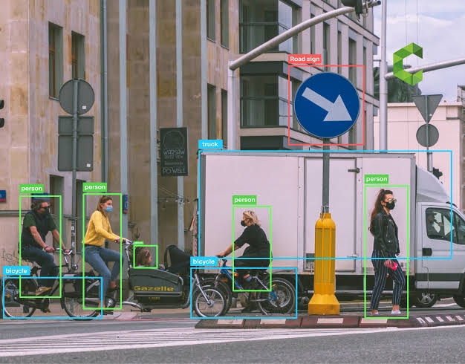
Problem Statement(Contd...) :
Definition:
Object detection is a computer vision technique for locating instances of objects in images or videos.
Object Detection= Object Classification + Object Localisation

Slide 5
Proposed System/Solution :
TensorFlow offers a robust toolkit for object detection, including various pre-trained models and the flexibility to build your own. Here are some common network architectures used for object detection with TensorFlow: 1.Faster R-CNN (Region-based Convolutional Neural Network):
This two-stage detector uses a region proposal network (RPN) to identify potential object locations and then classifies those regions. It delivers high accuracy but can be computationally expensive.

Slide 6
Proposed System/Solution(Contd...):
2.YOLO (You Only Look Once):
This single-stage detector performs both bounding box localization and classification in one go. It’s known for its speed, making it suitable for real-time applications, but may trade some accuracy for efficiency.
3.SSD (Single Shot MultiBox Detector):
Another single-stage detector, SSD achieves a balance between speed and accuracy. It utilizes multiple convolutional layers to predict bounding boxes at various scales within the image.
4.Tensor Flow Object Detection API:
This open-source framework simplifies object detection tasks. It provides pre-trained models based on architectures like Faster R-CNN and SSD, along with tools for training and deploying your custom models.

Slide 7
System Development Approach :
Hardware Requirements: CPU:
A decent CPU (Central Processing Unit) is necessary, with an Intel Core i5 6th generation or higher (or equivalent AMD processor) recommended as a minimum. More complex projects will benefit from a powerful CPU. RAM:
While 8GB of RAM is the minimum, 16GB or more is highly recommended. Training object detection models can be memory-intensive, especially with larger datasets or complex models. GPU (Optional, highly recommended):
A compatible NVIDIA GeForce GTX 940 or higher GPU (Graphics Processing Unit) with CUDA support significantly accelerates training and inference (running the model on new data). TensorFlow utilizes GPUs for faster computations.

Slide 8
System Development Approach(Contd...):
Software Requirements:
Operating System:
A 64-bit version of Microsoft Windows 10, Linux, or macOS is compatible. TensorFlow:
Install TensorFlow with GPU support if you have a compatible NVIDIA GPU. Double-check for compatibility between TensorFlow version, CUDA version, and cuDNN version. Python:
TensorFlow works within Python. Ensure you have Python installed with necessary libraries like NumPy and OpenCV. CUDA Toolkit & cuDNN (for GPU):
If using a GPU, you’ll need to install the NVIDIA CUDA Toolkit and cuDNN libraries which enable TensorFlow to leverage the GPU’s capabilities.

Slide 9
Algorithm and Deployment :
Algorithm:
To perform object detection using TensorFlow, you can follow these general steps: 1.Choose a Model
Select a pre-trained object detection model. TensorFlow provides several models like SSD, Faster R-CNN, and YOLO that you can use.
2.Prepare a Dataset:
Organize your dataset with images and corresponding annotations (bounding boxes and class labels).
3.Data Pre-processing:
Resize the images to the required input size for the model and normalize the pixel values. 4.Load the Model:
Load the chosen pre-trained model using TensorFlow’s object detection API.

Slide 10
Algorithm (Contd...):
5.Inference:
Perform inference on the input images using the loaded model to detect objects.
6.Post-processing:
Process the model output to extract the bounding boxes, class labels, and confidence scores of the detected objects.
7.Visualization:
Draw bounding boxes on the input images to visualize the detected objects.

Slide 11
Deployment :
Deploying an object detection model with TensorFlow involves several steps. 1.Training the Model:
Train your object detection model using TensorFlow. You can use a pre-trained model and fine-tune it on your dataset or train a model from scratch. 2.Exporting the Model:
Once you have a trained model, export it to a format suitable for deployment. TensorFlow provides tools like tf.saved_model.save or model. Save to save the model in a format like Saved Model or HDF5. 3.Conversion to TensorFlow Lite:
If you want to deploy your model on mobile or edge devices, you can convert it to TensorFlow Lite format using the TensorFlow Lite Converter.

Slide 12
Deployment (Contd...):
4.Deployment: TensorFlow Serving:
For serving models in a production environment, TensorFlow Serving is a common choice. It allows you to deploy your model as a service and provides APIs for making predictions. TensorFlow Lite Interpreter:
If you’re deploying on mobile or edge devices, you can use the TensorFlow Lite Interpreter to load and run your model.
TensorFlow.js
For deployment in web applications, you can use TensorFlow.js to load and run your model directly in the browser.

Slide 13
Deployment (Contd...):
5.Integration:
Integrate the deployed model into your application. This may involve writing code to load the model, pre-process input data, make predictions, and post-process the output for display or further processing.
6.Optimization:
Test your deployed model to ensure it performs as expected. You may also need to optimize your model for performance, especially on resource-constrained devices.

Slide 14
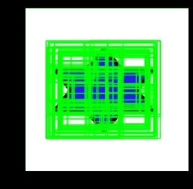

Result:
Fig. :Before Detection
Fig. :After Detection

Slide 15
References:
www.google.colab.com￼￼￼￼￼￼￼￼￼￼￼￼￼
Dataset:
https://www.kaggle.com/datasets/kishanj/simple-object-detection

Slide 16
Conclusion :
Object detection using TensorFlow can be a powerful tool for a variety of applications, from surveillance to image recognition. TensorFlow provides a flexible framework for building and training custom object detection models, allowing you to tailor the model to your specific needs. By leveraging pre-trained models and transfer learning, you can achieve impressive results with relatively little data.

Slide 17
Thank you

